Slide 1
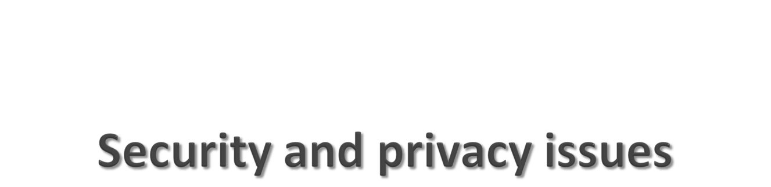
Chapter 10

Slide 2
System Vulnerability and Abuse
Why systems are vulnerable
  Accessibility of networks
  Hardware problems (breakdowns, configuration errors, damage from improper use or crime)
  Software problems (programming errors, installation errors, unauthorized changes)
  Disasters
  Use of networks/computers outside of firm’s control
  Loss and theft of portable devices
Notes:
This slide discusses the main categories of threats to information systems. Note that when large amounts of data are stored digitally, on computers and servers and in databases, they are vulnerable to many more kinds of threats than when they were stored in manual form, on paper in folders and file cabinets. When data are available over a network, there are even more vulnerabilities. Ask students if they have ever lost data on their computers. What was the reason (hardware, software, “disaster,” other people, etc.). On the other hand, digital records are not vulnerable in ways that manual records in a file cabinet are vulnerable. For instance, you really can’t tell who has accessed manual records, or when, in a physical file. In a database, file access is monitored (unless a hacker has found a way to read records without leaving a digital trail).

Slide 3
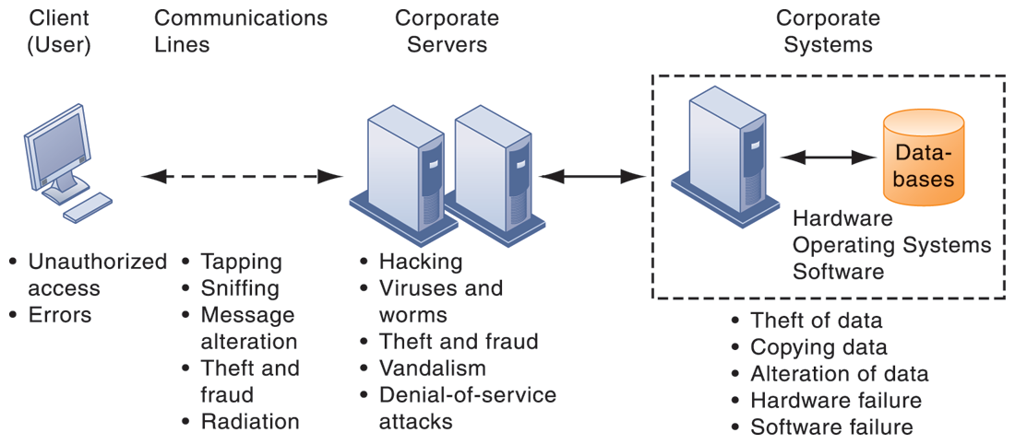
CONTEMPORARY SECURITY CHALLENGES AND VULNERABILITIES
FIGURE 8-1
The architecture of a Web-based application typically includes a Web client, a server, and corporate information systems linked to databases. Each of these components presents security challenges and vulnerabilities. Floods, fires, power failures, and other electrical problems can cause disruptions at any point in the network.
Notes:
This graphic illustrates the types of threats to system security and the points over the network at which these threats are prevalent. Some problems occur at the client computer, others through the network lines, corporate servers, or in corporate hardware and software.

Slide 4
System Vulnerability and Abuse
Internet vulnerabilities
  Network open to anyone
  Size of Internet means abuses can have wide impact
  Use of fixed Internet addresses with cable / DSL modems creates fixed targets for hackers
  Unencrypted VOIP
  E-mail, P2P, IM
    Interception
    Attachments with malicious software
    Transmitting trade secrets
Notes:
This slide discusses the types of threats that large public networks, such as the Internet, face because they are open to virtually anyone. Note that Internet is so huge that when abuses do occur, they can have an enormously widespread impact. And when the Internet becomes part of the corporate network, the organization’s information systems are even more vulnerable to actions from outsiders.

Slide 5
System Vulnerability and Abuse
Wireless security challenges
  Radio frequency bands easy to scan
  SSIDs (service set identifiers)
    Identify access points
    Broadcast multiple times
    Can be identified by sniffer programs
    War driving
      Eavesdroppers drive by buildings and try to detect SSID and gain access to network and resources
    Once access point is breached, intruder can use OS to access networked drives and files
Notes:
This slide discusses security threats related to wireless networks. Local area networks (LANs) using the 802.11 standard can be easily penetrated by outsiders armed with laptops, wireless cards, external antennae, and hacking software. Hackers use these tools to detect unprotected networks, monitor network traffic, and, in some cases, gain access to the Internet or to corporate networks. Ask students if they have connected to the Internet through an unknown wireless network that a person or business had established and left unprotected. Note that there are stronger encryption and authentication systems available for wireless networks but users must install them. Many Wi-Fi routers ship today with pre-installed security protection.

Slide 6
System Vulnerability and Abuse
Malware (malicious software)
  Viruses
    Rogue software program that attaches itself to other software programs or data files in order to be executed
  Worms
    Independent programs that copy themselves from one computer to other computers over a network.
  Worms and viruses spread by
    Downloads (drive-by downloads)
    E-mail, IM attachments
    Downloads on Web sites and social networks
Notes:
This slide identifies the various types of malware that threaten information systems and computers. Ask students if they have ever had a problem with a virus. Do they know how they got infected? Note that there are now more than 200 viruses and worms targeting mobile phones, and Web 2.0 applications such as MySpace and blogs are new conduits for malware and spyware. Malware is a serious problem—over the past decade, worms and viruses have caused billions of dollars of damage to corporate networks, e-mail systems, and data.

Slide 7
System Vulnerability and Abuse
Malware (cont.)
  Smartphones as vulnerable as computers
    Study finds 13,000 types of smartphone malware
  Trojan horses
    Software that appears benign but does something other than expected
  SQL injection attacks
    Hackers submit data to Web forms that exploits site’s unprotected software and sends rogue SQL query to database
  Ransomware
Notes:
This slide continues the discussion of types of malware on the previous slide. Note that SQL injection attacks are the largest malware threat. Ask students why this is so. (These attacks enable hackers access to underlying databases that support Web applications, such as sales of products and services, e-commerce financial data, and other classified information. In other words, the database is where the information is located. SQL databases have little or no built in security once a hacker gets beyond the entrance point to a corporate network).

Slide 8
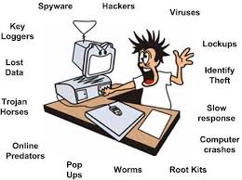

Slide 9
System Vulnerability and Abuse
Malware (cont.)
  Spyware
    Small programs install themselves surreptitiously on computers to monitor user Web surfing activity and serve up advertising
    Key loggers
      Record every keystroke on computer to steal serial numbers, passwords, launch Internet attacks
    Other types:
      Reset browser home page
      Redirect search requests
      Slow computer performance by taking up memory
Notes:
This slide continues the discussion of malware.

Slide 10
System Vulnerability and Abuse
Hackers and computer crime
  Activities include:
    System intrusion
    System damage
    Cybervandalism
      Intentional disruption, defacement, destruction of Web site or corporate information system
Notes:
This slide looks at the people who commit computer crime, and at the various types of computer crime.

Slide 11
System Vulnerability and Abuse
Spoofing
  Misrepresenting oneself by using fake e-mail addresses or masquerading as someone else
  Redirecting Web link to address different from intended one, with site masquerading as intended destination
Sniffer
  Eavesdropping program that monitors information traveling over network
  Enables hackers to steal proprietary information such as e-mail, company files, and so on
Notes:
This slide continues the discussion of different types of computer crimes. Ask students what the ultimate purpose of spoofing and sniffing are. Note that there are legitimate uses of sniffing—sniffers can help identify network trouble spots or spot criminal activity on a network. Sniffers can also be used to identify copyrighted data being sent over networks, such as pirated music or video files.

Slide 12
System Vulnerability and Abuse
Denial-of-service attacks (DoS)
  Flooding server with thousands of false requests to crash the network
Distributed denial-of-service attacks (DDoS)
  Use of numerous computers to launch a DoS
  Botnets
    Networks of “zombie” PCs infiltrated by bot malware
    Deliver 90 percent of world spam, 80 percent of world malware
    Grum botnet: controlled 560K to 840K computers
Notes:
This slide continues the discussion of the types of computer crimes. What is the result of a DoS attack? The text gives the example of the Grum botnet, which was responsible for 18% of worldwide spam traffic (18 billion messages a day) until it was shut down on July 19, 2012. Bots and botnets are an extremely serious threat because they can be used to launch very large attacks using many different techniques.

Slide 13
System Vulnerability and Abuse
Computer crime
  Defined as “any violations of criminal law that involve a knowledge of computer technology for their perpetration, investigation, or prosecution”
  Computer may be target of crime, for example:
    Breaching confidentiality of protected computerized data
    Accessing a computer system without authority
  Computer may be instrument of crime, for example:
    Theft of trade secrets
    Using e-mail for threats or harassment
Notes:
This slide looks at the legal definition of computer crime and the two main classes of computer crime. The text lists a variety of other examples for computers as targets and as instruments of crime. Ask the students to provide more examples. According to the Ponemon Institute, the median annual cost of cybercrime for organizations in their study was $5.9 million. However, many companies are reluctant to report computer crimes. Why? What are the most economically damaging types of computer crime? (DoS, introducing viruses, theft of services, disruption of computer systems)

Slide 14
System Vulnerability and Abuse
Identity theft
  Theft of personal Information (social security ID, driver’s license, or credit card numbers) to impersonate someone else
Phishing
  Setting up fake Web sites or sending e-mail messages that look like legitimate businesses to ask users for confidential personal data
Evil twins
  Wireless networks that pretend to offer trustworthy Wi-Fi connections to the Internet
Notes:
This slide continues the discussion of types of computer crime. Have any students encountered any of these types of crimes personally? Note that The U.S. Congress addressed the threat of computer crime in 1986 with the Computer Fraud and Abuse Act. This act makes it illegal to access a computer system without authorization. The text lists other legislation to counter computer crime, such as the National Information Infrastructure Protection Act in 1996 to make virus distribution and hacker attacks to disable Web sites federal crimes.

Slide 15
System Vulnerability and Abuse
Pharming
  Redirects users to a bogus Web page, even when individual types correct Web page address into his or her browser
Click fraud
  Occurs when individual or computer program fraudulently clicks on online ad without any intention of learning more about the advertiser or making a purchase
Cyberterrorism and Cyberwarfare
Notes:
This slide continues the discussion of types of computer crime. Note that cybercriminal activities are borderless: The global nature of the Internet makes it possible for cybercriminals to operate anywhere in the world. Ask students if there should be legislation outlawing click fraud. One concern is the use of computer attacks by organized governments, and that such attacks might target major infrastructure such as electrical grids. The text says that at least 20 countries, including China, are believed to be developing offensive and defensive cyberwarfare capabilities. One of the leading, if not the leading, countries in cyberwarfare is the United States.

Slide 16
System Vulnerability and Abuse
Internal threats: Employees
  Security threats often originate inside an organization
  Inside knowledge
  Sloppy security procedures
    User lack of knowledge
  Social engineering:
    Tricking employees into revealing their passwords by pretending to be legitimate members of the company in need of information
Notes:
This slide looks at another source of security problems—people inside the company with access to the system. Ask students if they have ever worked somewhere with a vulnerable password system. Have they ever revealed to anyone what their password is or was? What are some solutions to password security? Some financial institutions assign users a new password every day, or every hour.

Slide 17
System Vulnerability and Abuse
Software vulnerability
  Commercial software contains flaws that create security vulnerabilities
    Hidden bugs (program code defects)
      Zero defects cannot be achieved because complete testing is not possible with large programs
    Flaws can open networks to intruders
  Patches
    Small pieces of software to repair flaws
    Exploits often created faster than patches can be released and implemented
Notes:
This slide looks at security and other vulnerabilities caused by software errors that open networks to intruders. The text cites the example of a database-related software error that prevented millions of JP Morgan Chase retail and small-business customers from accessing their online bank accounts for two days in September 2010. Ask students why complete testing is not possible with large programs.
The text also gives the example of Microsoft’s service pack upgrades to its operating system software. Service Pack 1 for Vista included security enhancements to counter malware and hackers.

Slide 18
Organizational Frameworks for Security and Control
Information systems controls
  Manual and automated controls
  General and application controls
General controls
  Govern design, security, and use of computer programs and security of data files in general throughout organization’s information technology infrastructure
  Apply to all computerized applications
  Combination of hardware, software, and manual procedures to create overall control environment
Notes:
To improve security for a firm‘s information systems, it is important to create a framework that supports security. This includes establishing information systems controls, understanding the risks to the firm’s information systems, and establishing security policies that are appropriate for the firm. This slide looks at controls used in information systems. Remember that controls are methods, policies, and organizational procedures that ensure safety of organization’s assets; accuracy and reliability of its accounting records; and operational adherence to management standards. Controls may be manual or automated. Ask students to explain the difference between manual and automated controls (e.g., making sure that computer storage areas are secure vs. automated virus updates.) There are two main types of controls: general controls and application controls. General controls apply to all computerized applications. A list of types of general controls appears on the next slide. Ask students what the functions are of the different types of general controls.

Slide 19
Organizational Frameworks for Security and Control
Types of general controls
  Software controls
  Hardware controls
  Computer operations controls
  Data security controls
  Implementation controls
  Administrative controls
Notes:
This slide lists the different categories of general controls. Ask students what the functions are of the different types of general controls.

Slide 20
Organizational Frameworks for Security and Control
Application controls
  Specific controls unique to each computerized application, such as payroll or order processing
  Include both automated and manual procedures
  Ensure that only authorized data are completely and accurately processed by that application
  Include:
    Input controls
    Processing controls
    Output controls
Notes:
This slide examines the second type of information systems controls, application controls. Ask students what each type of application control does. (Input controls check data for accuracy and completeness when they enter the system. There are specific input controls for input authorization, data conversion, data editing, and error handling. Processing controls establish that data are complete and accurate during updating. Output controls ensure that the results of computer processing are accurate, complete, and properly distributed.)

Slide 21
Organizational Frameworks for Security and Control
Risk assessment: Determines level of risk to firm if specific activity or process is not properly controlled
    Types of threat
    Probability of occurrence during year
    Potential losses, value of threat
    Expected annual loss
EXPOSURE | PROBABILITY | LOSS RANGE (AVG) | EXPECTED ANNUAL LOSS
Power failure | 30% | $5K–$200K ($102,500) | $30,750
Embezzlement | 5% | $1K–$50K ($25,500) | $1,275
User error | 98% | $200–$40K ($20,100) | $19,698
Notes:
This slide looks at another important factor in establishing an appropriate framework for security and control, risk assessment. Although not all risks can be anticipated and measured, most businesses should be able identify many of the risks they face. The table illustrates sample results of a risk assessment for an online order processing system that processes 30,000 orders per day. The likelihood of each exposure occurring over a one-year period is expressed as a percentage. The expected annual loss is the result of multiplying the probability by the average loss. Ask students to rank the three risks listed here in order of most important to minimize.

Slide 22
Organizational Frameworks for Security and Control
Security policy
  Ranks information risks, identifies acceptable security goals, and identifies mechanisms for achieving these goals
  Drives other policies
    Acceptable use policy (AUP)
      Defines acceptable uses of firm’s information resources and computing equipment
    Authorization policies
      Determine differing levels of user access to information assets
Notes:
This slide looks at the need for a firm to establish a security policy for protecting a company’s assets, as well as other company policies the security policy drives, and how information systems support this. The text provides the example of the security policy at Unilever, a multinational consumer goods company, which requires every employee with a laptop or mobile handheld to use an approved device and employ a password or other method of identification when logging onto the corporate network. Ask students what types of issues would be covered under an AUP. (Privacy, user responsibility, and personal use of company equipment and networks, unacceptable and acceptable actions for every user, and consequences for noncompliance.)

Slide 23
Organizational Frameworks for Security and Control
Identity management
  Business processes and tools to identify valid users of system and control access
    Identifies and authorizes different categories of users
    Specifies which portion of system users can access
    Authenticating users and protects identities
  Identity management systems
    Captures access rules for different levels of users
Notes:
This slide looks at the area of security policy involved in managing identities of system users. Ask students why businesses consider it important to specify which portion of an information system a user has access to? What kinds of information requires very high levels of security access? What rules might be used to determine access rules? One rule is “need to know.”

Slide 24
Organizational Frameworks for Security and Control
Disaster recovery planning: Devises plans for restoration of disrupted services
Business continuity planning: Focuses on restoring business operations after disaster
  Both types of plans needed to identify firm’s most critical systems
  Business impact analysis to determine impact of an outage
  Management must determine which systems restored first
Notes:
This slide continues the discussion of essential activities a firm performs to maximize security and control, here looking at planning for activities should a disaster occur, such as a flood, earthquake, or power outage. Note that disaster recovery plans focus primarily on the technical issues involved in keeping systems up and running, such as which files to back up and the maintenance of backup computer systems or disaster recovery services. The text provides the example of MasterCard, which maintains a duplicate computer center in Kansas City, Missouri, to serve as an emergency backup to its primary computer center in St. Louis. Ask students why it is important that both business managers and information systems specialists work together on these plans.

Slide 25
Organizational Frameworks for Security and Control
Information systems audit
  Examines firm’s overall security environment as well as controls governing individual information systems
  Reviews technologies, procedures, documentation, training, and personnel
  May even simulate disaster to test response of technology, IS staff, other employees
  Lists and ranks all control weaknesses and estimates probability of their occurrence
  Assesses financial and organizational impact of each threat
Notes:
This slide looks at the role of auditing. An MIS audit enables a firm to determine if existing security measures and controls are effective.

Slide 26
Tools and Technologies for Safeguarding Information Resources
Identity management software
  Automates keeping track of all users and privileges
  Authenticates users, protecting identities, controlling access
Authentication
  Password systems
  Tokens
  Smart cards
  Biometric authentication
  Two-factor authentication
Notes:
This slide looks at the technologies used for identifying and authenticating users. Ask students which of the various authentication methods seem to be the most fool proof. Passwords are traditional methods for authentication and newer methods include tokens, smart cards, and biometric authentication. Have any students used authentication methods other than passwords to access a system? Ask students to give examples of things that can be used for biometric authentication (voices, irises, fingerprints, palmprints, face recognition.) Some PCs can be ordered with fingerprint authentication of the user. What are some problems with strict biometric authentication for PCs?

Slide 27
Tools and Technologies for Safeguarding Information Resources
Firewall:
  Combination of hardware and software that prevents unauthorized users from accessing private networks
  Technologies include:
    Static packet filtering
    Stateful inspection
    Network address translation (NAT)
    Application proxy filtering
Notes:
This slide looks at an essential tool used to prevent intruders from accessing private networks—firewalls. To create a strong firewall, an administrator must maintain detailed internal rules identifying the people, applications, or addresses that are allowed or rejected. Firewalls can deter, but not completely prevent, network penetration by outsiders and should be viewed as one element in an overall security plan.
Ask students to differentiate between the screening technologies listed here. Note that these are often used in combination. Ask students if they use firewall software on their own computers.

Slide 28
Tools and Technologies for Safeguarding Information Resources
Intrusion detection systems:
  Monitors hot spots on corporate networks to detect and deter intruders
  Examines events as they are happening to discover attacks in progress
Antivirus and antispyware software:
  Checks computers for presence of malware and can often eliminate it as well
  Requires continual updating
Unified threat management (UTM) systems
Notes:
This slide looks at additional tools to prevent unwanted intruders and software from accessing the network. Ask students what antivirus and antispyware tools they use. Ask why these tools require continual updating. Ask why UTM packages would include anti-spam software.

Slide 29
Tools and Technologies for Safeguarding Information Resources
Securing wireless networks
  WEP security can provide some security by:
    Assigning unique name to network’s SSID and not broadcasting SSID
    Using it with VPN technology
  Wi-Fi Alliance finalized WPA2 specification, replacing WEP with stronger standards
    Continually changing keys
    Encrypted authentication system with central server
Notes:
This slide looks at the tools and technologies used to secure wireless networks. Ask students with laptops what types of wireless security they have available to them, and which one they use.

Slide 30
Tools and Technologies for Safeguarding Information Resources
Encryption:
  Transforming text or data into cipher text that cannot be read by unintended recipients
  Two methods for encryption on networks
    Secure Sockets Layer (SSL) and successor Transport Layer Security (TLS)
    Secure Hypertext Transfer Protocol (S-HTTP)
Notes:
This slide introduces the use of encryption to ensure that data traveling along networks cannot be read by unauthorized users. Ask students what encryption involves: use of encryption key (a numerical code) that is used to transform a message into undecipherable text. The cipher text requires a key to decrypted and read by the recipient.

Slide 31
Tools and Technologies for Safeguarding Information Resources
Digital certificate:
  Data file used to establish the identity of users and electronic assets for protection of online transactions
  Uses a trusted third party, certification authority (CA), to validate a user's identity
  CA verifies user’s identity, stores information in CA server, which generates encrypted digital certificate containing owner ID information and copy of owner’s public key
Public key infrastructure (PKI)
  Use of public key cryptography working with certificate authority
  Widely used in e-commerce
Notes:
This slide looks at the use of digital certificates as a tool to help protect online transactions. Digital certificates are used in conjunction with public key encryption to validate the identities of two parties in a transaction before data is exchanged.

Slide 32
Tools and Technologies for Safeguarding Information Resources
Ensuring system availability
  Online transaction processing requires 100% availability, no downtime
Fault-tolerant computer systems
  For continuous availability, for example, stock markets
  Contain redundant hardware, software, and power supply components that create an environment that provides continuous, uninterrupted service
Notes:
This slide and the next look at technologies and tools for ensuring system availability. Ask students why online transaction processing requires 100% availability. Note that firms with heavy e-commerce processing or for firms that depend on digital networks for their internal operations require at minimum high-availability computing, using tools such as backup servers, distribution of processing across multiple servers, high-capacity storage, and good disaster recovery and business continuity plans.

Slide 33
Tools and Technologies for Safeguarding Information Resources
Controlling network traffic
  Deep packet inspection (DPI)
    Examines data files and sorts low priority material
    Can block video and music downloads
Security outsourcing
  Managed security service providers (MSSPs)
Notes:
This slide continues the discussion of techniques to minimize downtime and improve network performance. Deep packet inspection enables a network to sort low-priority data packets from high-priority ones in order to improve performance for business critical communication. Ask students what types of network traffic would be suitable for assigning lower priority in a business setting?

